Slide 1



UNIT 1
LESSON 2
MONEY MATTERS
Part 4

Slide 2
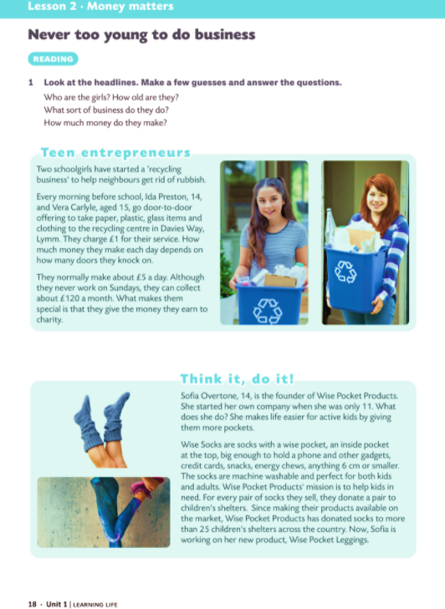
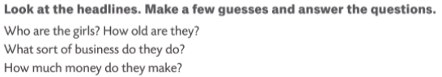

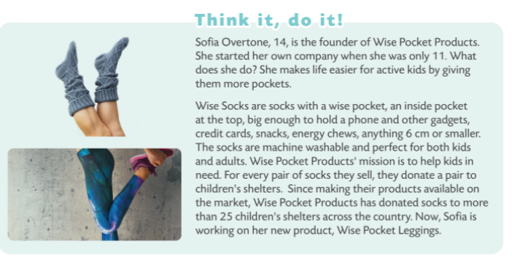

Slide 3
Match the words/expressions from two columns.
get rid of
start
go
charge for
give money to
take part in
knock on
give
impress
your service
a presentation
many doors
a business
the audience
charity
door-to-door
a competition
rubbish
get rid of rubbish
start a business
go door-to-door
charge for your service
give money to charity
take part in a competition
knock on many doors
give a presentation
impress the audience

Slide 4
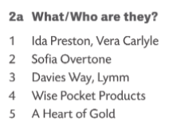


1 They are two schoolgirls who have started their own business. They are two young entrepreneurs.
2 She is the founder of Wise Pocket Products. She’s also a young entrepreneur.
3 It is a town where Ida and Vera live and work.
4 That is the name of Sofia’s company.
5 It is a competition.
Ida is 14 years old. Vera is 15. They charge £1 for their service. They normally make £5 a day. Vera and Ida can collect about £120 a month. Wise Pocket Products has donated socks to more than 25 children’s shelters across the country.

Slide 5

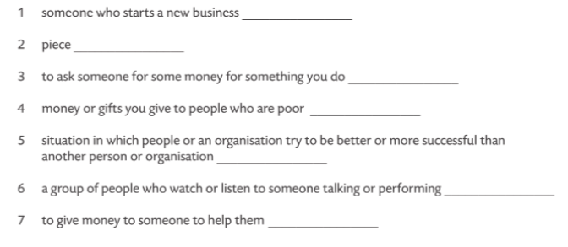


How do you like the girls? What’s interesting about them?
What are you impressed with? or What is the best thing of all?
What else would you like to know?
enterpreneur
item
charge
charity
competition
audience
donate
Cyber Monday

Slide 6
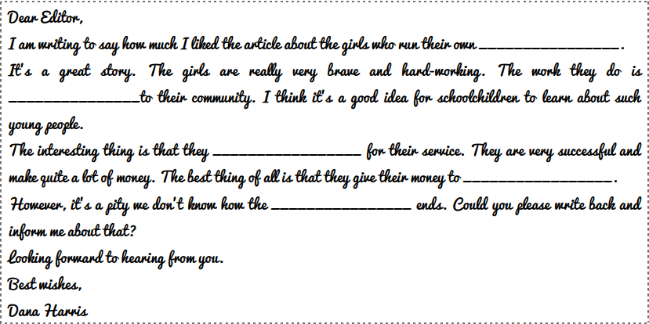
Complete a letter to an editor.
business
useful
charge
charity
competition

